Slide 1
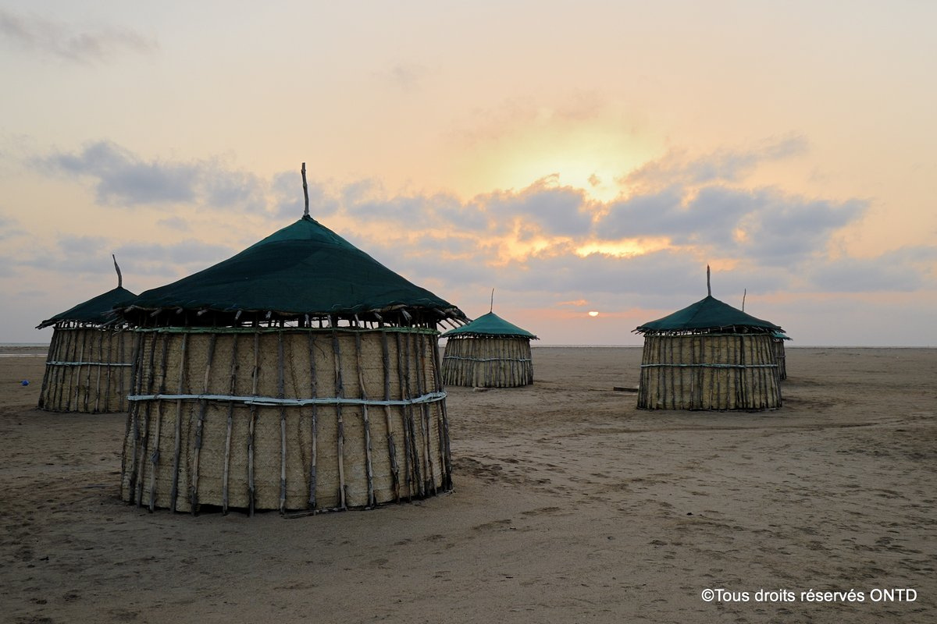




RÉPUBLIQUE DE DJIBOUTI
---------------------
UNITÉ - EQUALITÉ - PAIX
------------------------
MINISTÈRE DU COMMERCE ET DU TOURISME
INVESTMENT OPPORTUNITIES IN DJIBOUTI

Slide 2

DEVELOPMENT AND VALRISATION PROJECTS FOR TOURISTICS SITES
To transform our goals into reality

Slide 3
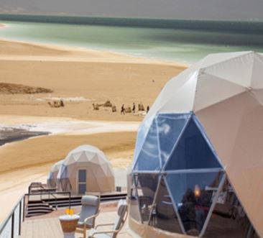
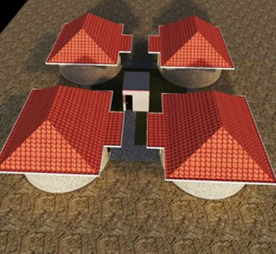
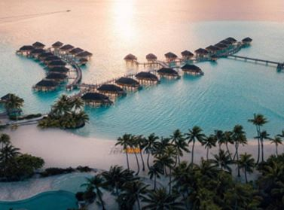
Increase accommodation capacity in the inland regions of the country.

Slide 4
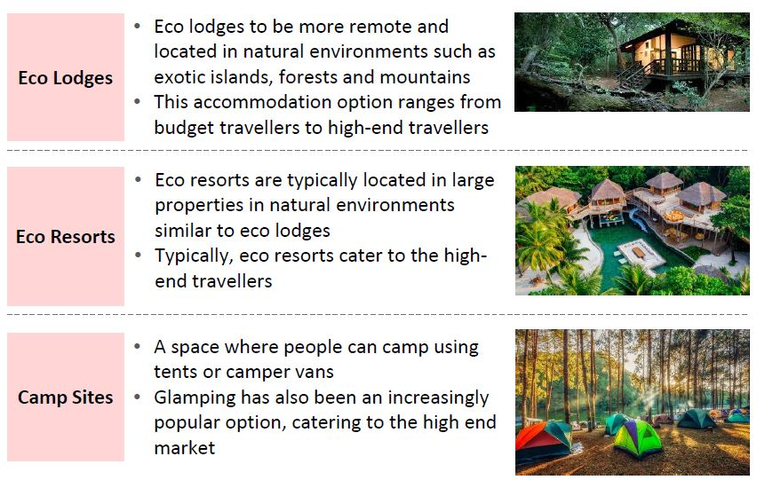
Natural accommodations
Nature-based accommodation structures help diversify and enhance the existing tourism offer.
Suitable locations for these types of projects
•Lake Assal
•Lake Abbe
•Day forest
• Assamo
•Khor Ambado
•

Slide 5
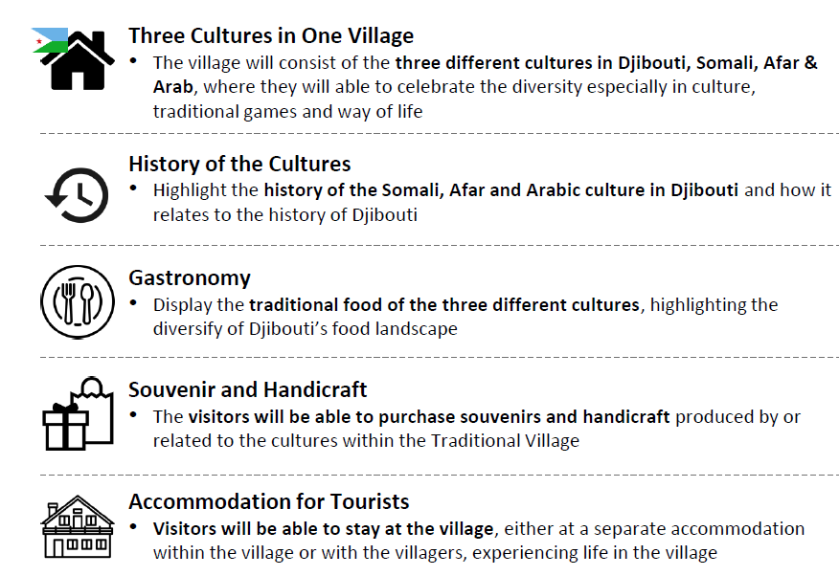
Cultural village
The development of a cultural village to offer visitors an immersive experience of local lifestyles and traditions.
Suitable locations for these types of projects
•Assamo
• Randa
• Etc…

Slide 6
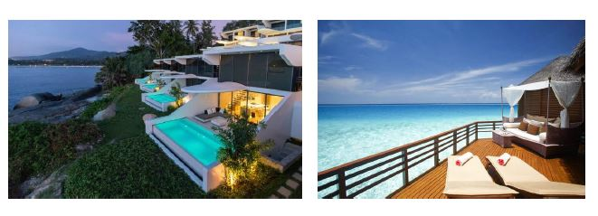
Development of Resorts
The development of seaside resorts around key attraction sites offers new opportunities to enhance coastal areas.
Suitable locations for these types of projects
•Iles Mouche et Maskali
• Godoria
• Arta beach

Slide 7
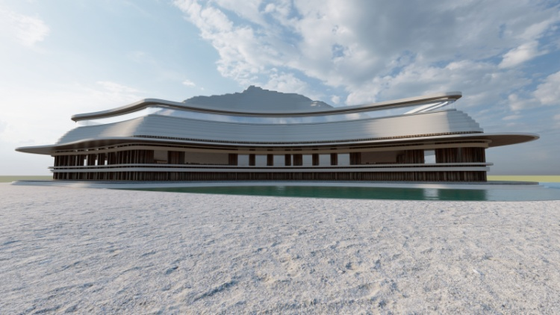
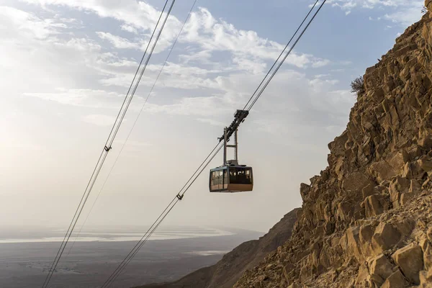
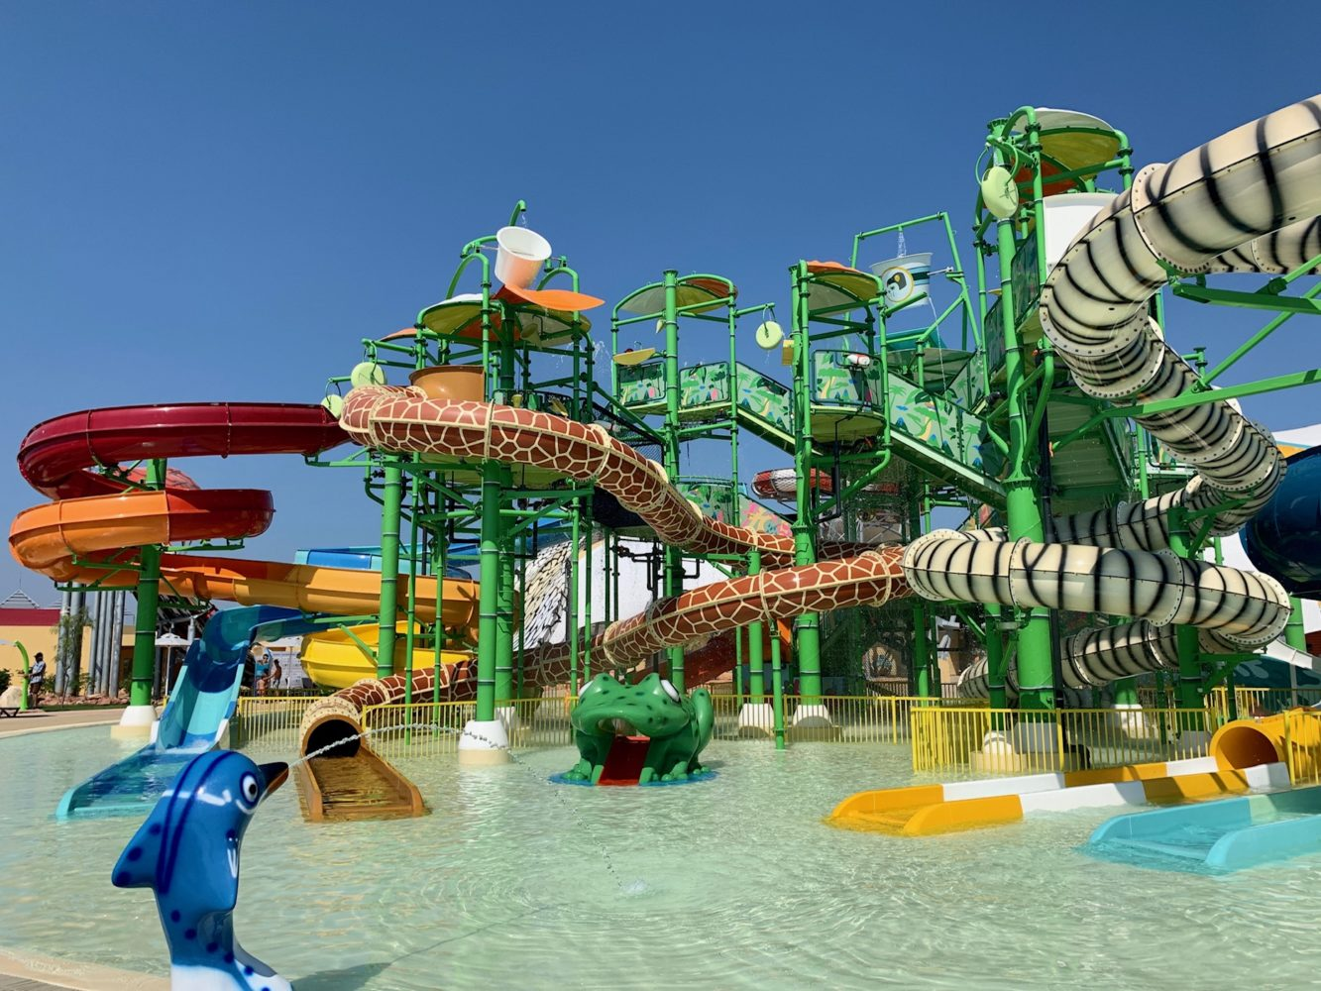
The development and expansion of leisure infrastructures aim to improve the quality of the touristic experience offered to visitors.

Slide 8
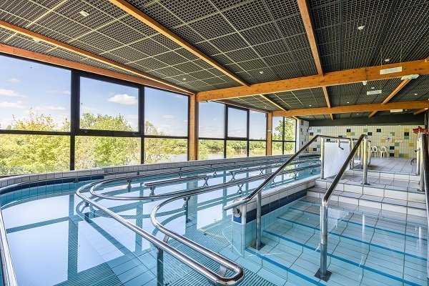
Thermal station
The establishment of a thermal spa to attract international visitors seeking wellness and relaxation.
Suitable locations for these types of projects
•Lake Assal
• Lake Abbé

Slide 9
Water park
The project to develop leisure infrastructures, such as a cable car station, aims to offer visitors breathtaking views of natural landscapes and help strengthen the country’s tourism attraction.
Suitable locations for these types of projects
•Arta Beach
• Douda Beach
• Khor Ambado Beach
• Ile Moucha et Maskali
• Godoria Beach

Slide 10
Cable car station
Djibouti has advantages for the development of leisure infrastructure such as a cable car station. The cable car would provide visitors with a unique and spectacular perspective of Djibouti's magnificent landscapes, including its mountains, coastlines and unique geological formations, thereby allowing simultaneous discovery of these natural wonders. This attraction would attract a large number of tourists looking for new experiences, thus increasing the number of visitors and extending their stay.
Suitable locations for these types of projects
•Arta Beach
• Day Forest

Slide 11
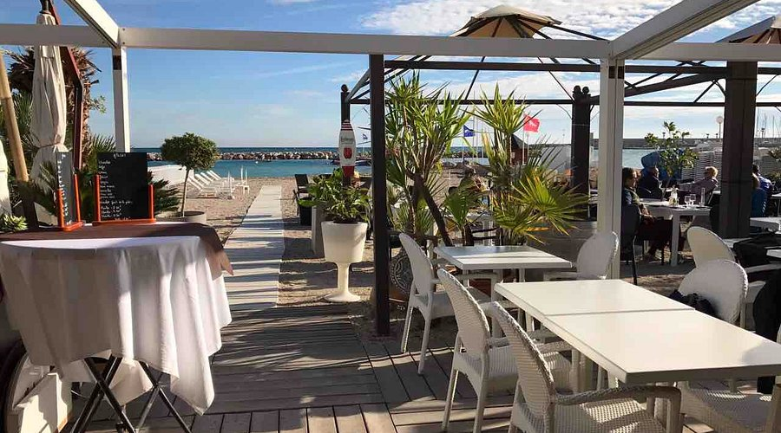
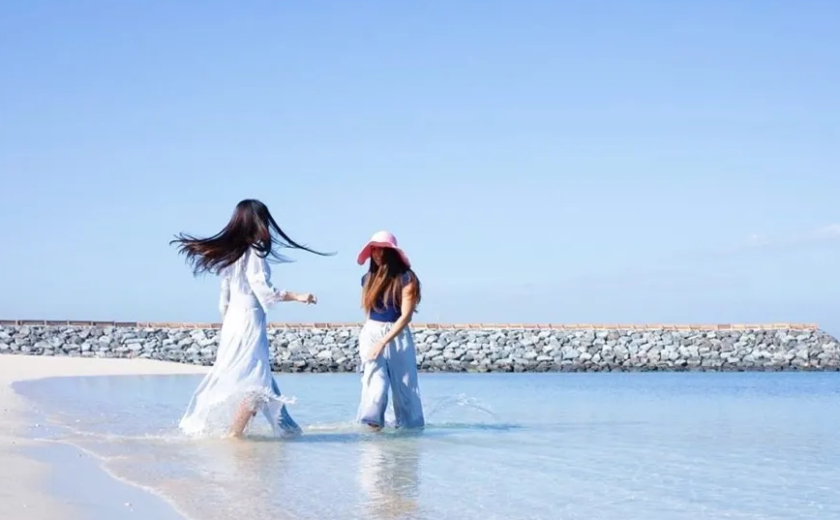
BEACH FOR WOMEN
Development of a secure beach exclusively dedicated to women, incorporating relaxation areas, seaside leisure activities, wellness spaces, and appropriately adapted facilities.
Suitable locations for these types of projects
• Triton beach

Slide 12
The development of key infrastructures serves as a strategic lever to strengthen the tourism sector. These efforts aim to provide visitors with high-quality facilities.

Slide 13
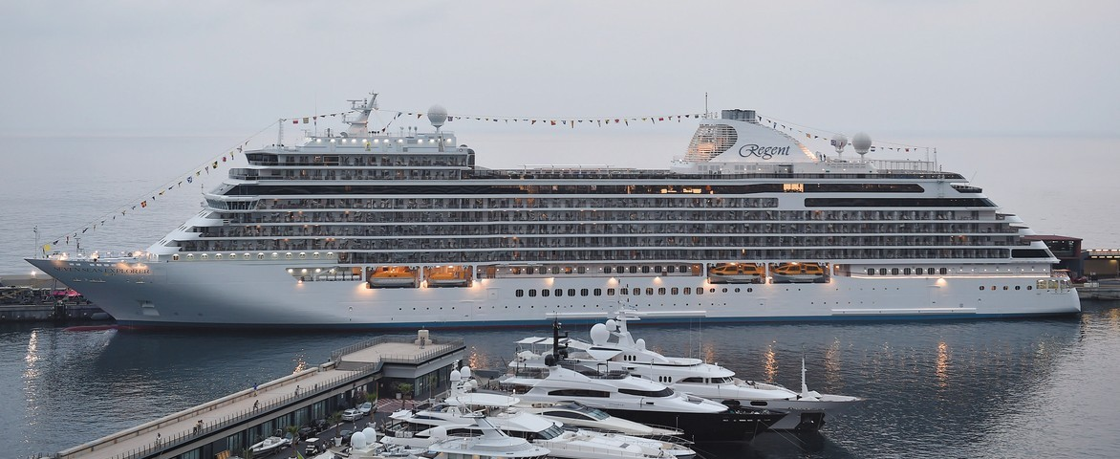
Development of a Marina
The development of a marina in Djibouti is part of a strategy to enhance the country’s coastline.
It offers high-quality facilities for nautical activities, recreational boating, and the reception of cruise ships.
As a true hub of attraction, the marina contributes to boosting the local economy through job creation and the development of related services (restaurants, crafts, leisure activities, etc.).
It also helps enhance Djibouti’s brand as a tourism destination.
Suitable locations for these types of projects
•Djibouti old Port

Slide 14

The National Tourism Agency stands ready to support and accompany any tourism investment project that contributes to the development of tourism, hospitality, and leisure in Djibouti. These initiatives may be implemented through public-private partnerships (PPPs) to share risks while ensuring the preservation of sensitive areas, particularly those designated as protected sites.

Slide 15




NATIONAL TOURISM AGENCY OF DJIBOUTI
THANK YOU FOR YOUR KIND ATTENTION!!
+253 21 35 28 00
infotourisme@visitdjibouti.dj
www.visitdjibouti.dj

