Slide 1
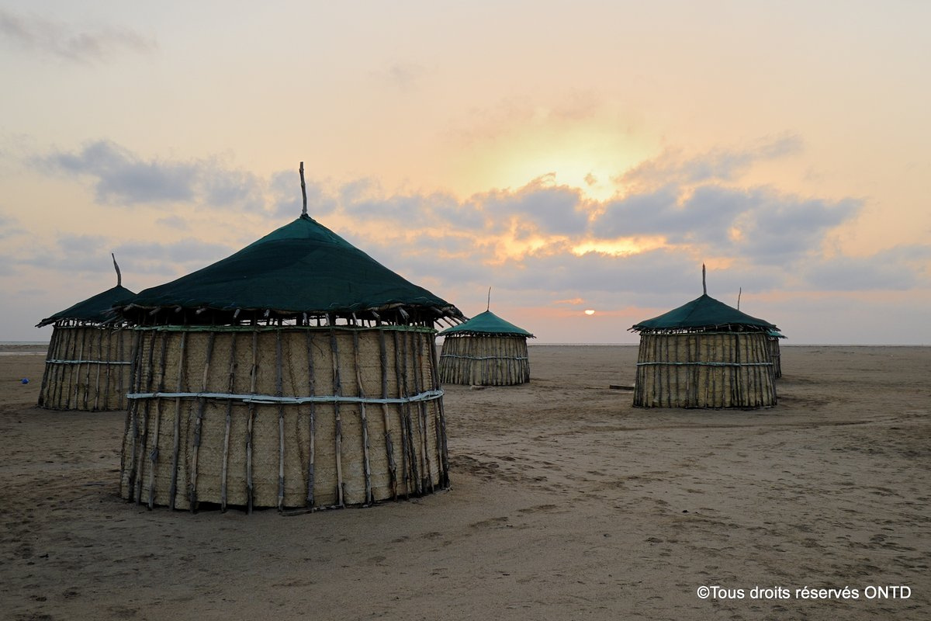
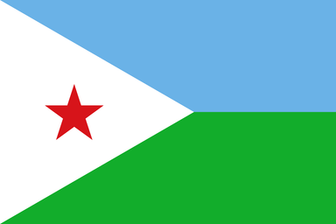



RÉPUBLIQUE DE DJIBOUTI
---------------------
UNITÉ - EQUALITÉ - PAIX
------------------------
MINISTÈRE DU COMMERCE ET DU TOURISME
TOURISTICS POTENTIALITIES IN DJIBOUTI

Slide 2
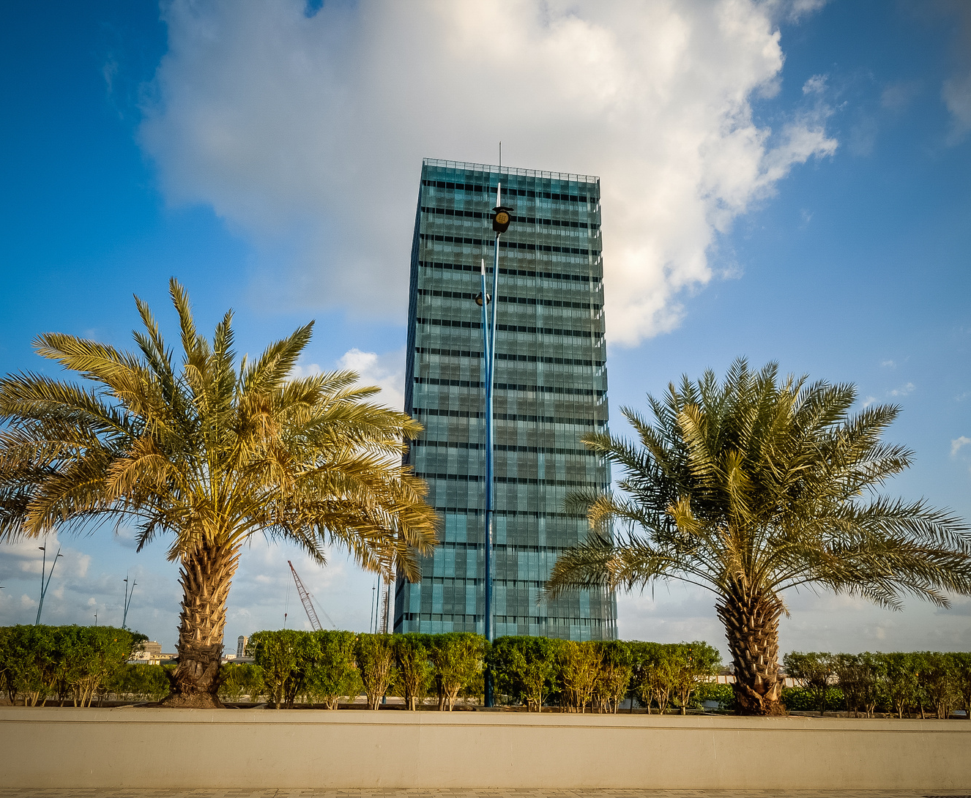
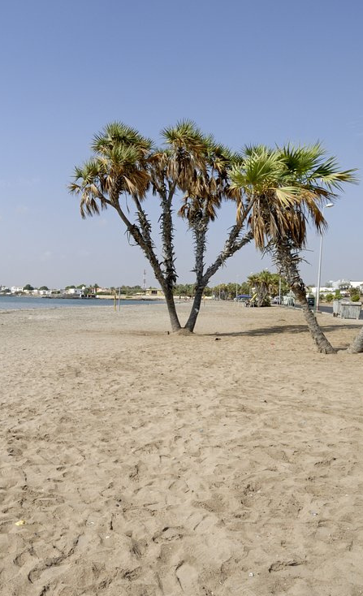
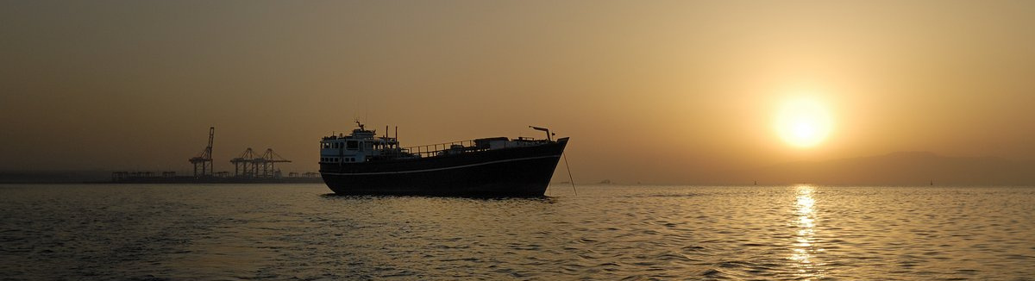
  Located in the Horn of Africa, at the crossroads of the Red Sea and the Indian Ocean, Djibouti enjoys a strategical position between 3 continents: Africa, Europe and Asia. The country is also located on one of the world's major shipping routes.
  A haven of peace and stability, Djibouti aims to emerge as a leading touristic destination.
  Indeed, the country has exceptional natural assets for developing tourism, including marine flora and fauna of great beauty, geological landscapes that are unique in the world and a rich cultural and archaeological heritage.
  Its exceptional sites, swimming in sumptuous seas, the warm welcome of its people can only encourage tourists and travelers who want beauty and a change of scenery to love and appreciate this beautiful country.

Slide 3
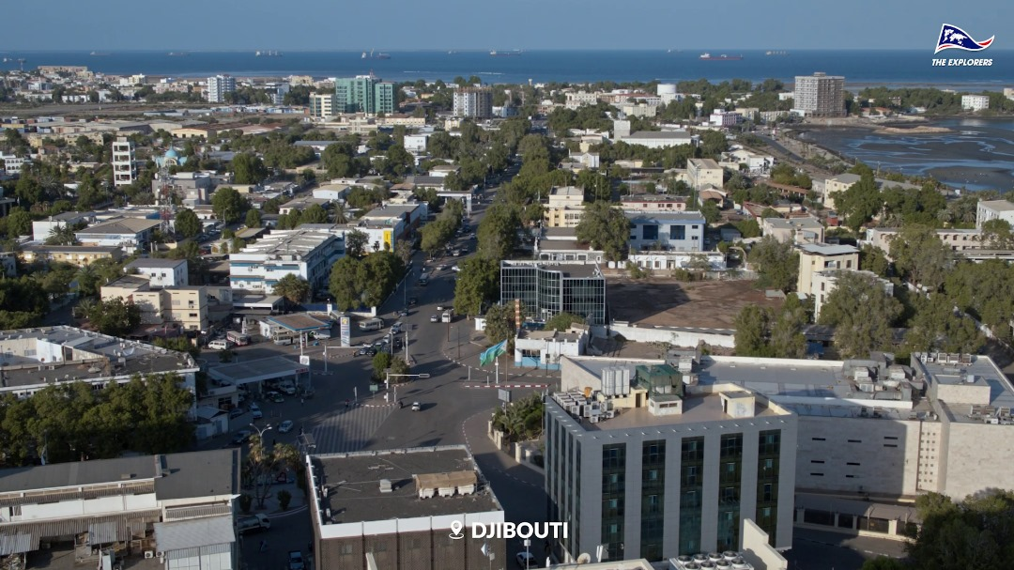
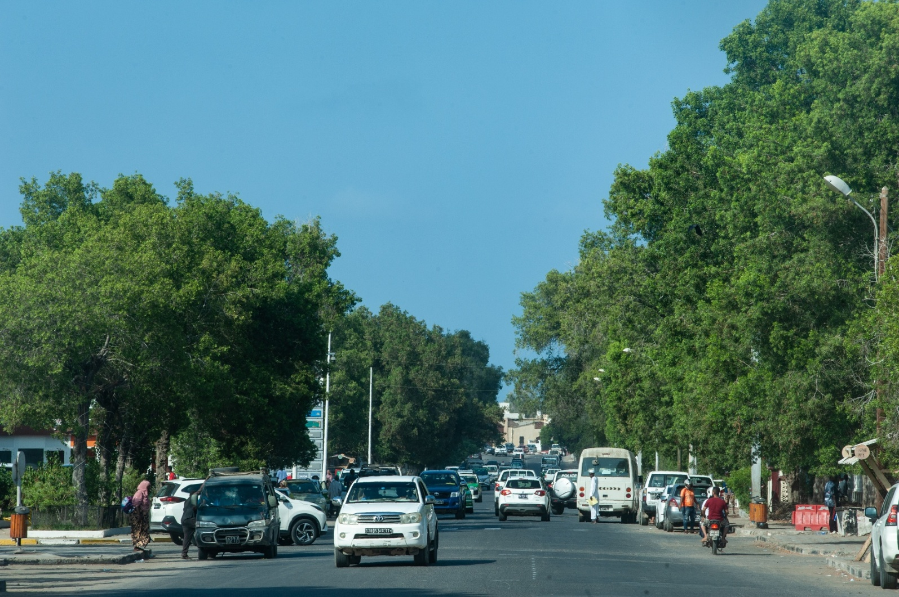
Profil du pays
GDP per capita: $1,597 USD
Major Investor Countries:
China, Gulf countries, Ethiopia, Turkey, France, United States of America, etc...
Independence Date:
June 27, 1977
Area:
23,200 sqm
Population:
1 174 740 inhabitants
National Languages:
Somali and Afar
Official Languages:
French and Arabic
Climate:
Desert and arid
Average Temperature:
25 °C - 43 °C
04

Slide 4
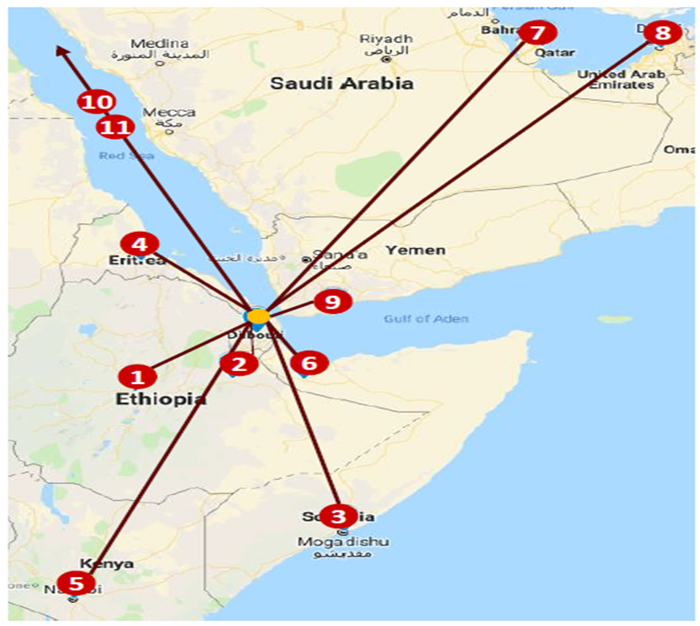
  A positive development in Djibouti's connectivity over the last 10 years: In addition to the national airline Air Djibouti, there are currently 6 international airlines, including Air France, Turkish Airlines, Ethiopian Airlines, Qatar Airways, Fly Dubai, Flynas which serve Djibouti with direct flights to several cities such as (Paris, Istanbul, Doha, Dubai, Addis Ababa, Jeddah). Other airlines will be operational soon.
  In January 2018, Djibouti introduced an electronic visa system and reduced visa fees from USD 80 to USD 10.
  Project to build a new airport in Biidley.

Slide 5
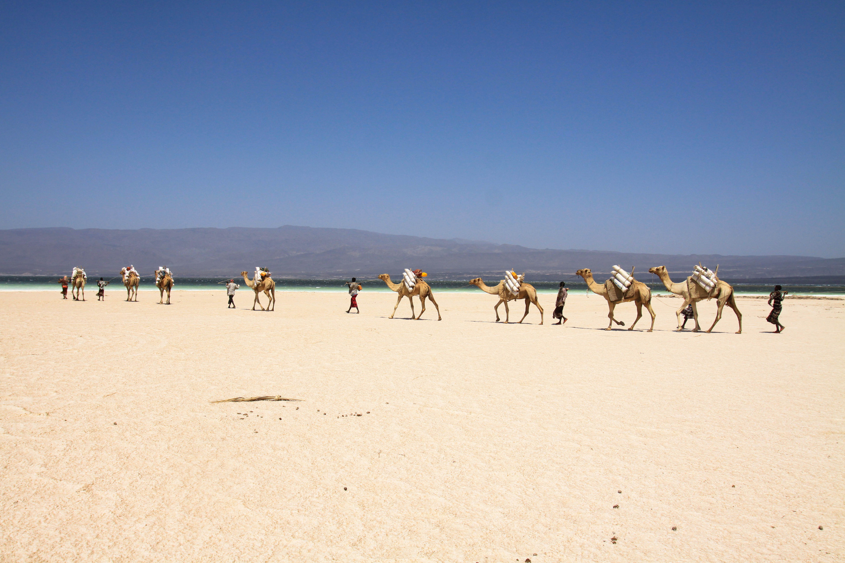
Aware of the country's tourism potential, the Government of the Republic of Djibouti defined Tourism in 2014, in its strategic development plan for the country entitled "Djibouti Vision 2035" as a priority sector.
In April and June 2019, Djibouti successively adopted a new strategic orientation law for the development of tourism as well as a master plan for the development of sustainable tourism for the period 2019-2024.
Goals:
  Exploit the great potential for tourism investment as a catalyst for Djibouti’s sustainable economy;
  Register the Djibouti destination at the international level by taking into account exceptional tourist sites

Slide 6

The project to build a new Airport named El HAJI HASSAN GOULED APTIDON airport with a capacity of 1.5 million annual passengers. Our goal is to reach 500,000 tourists per year.

Slide 7
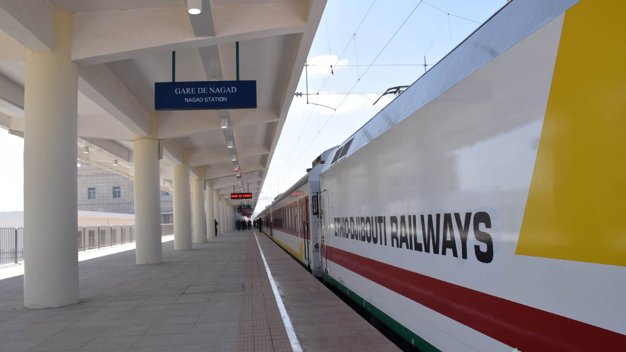
A modern and vital railway to increase tourist arrivals, it is also the first electric line which connects two capitals in Africa (Djibouti – Addis Ababa)

Slide 8
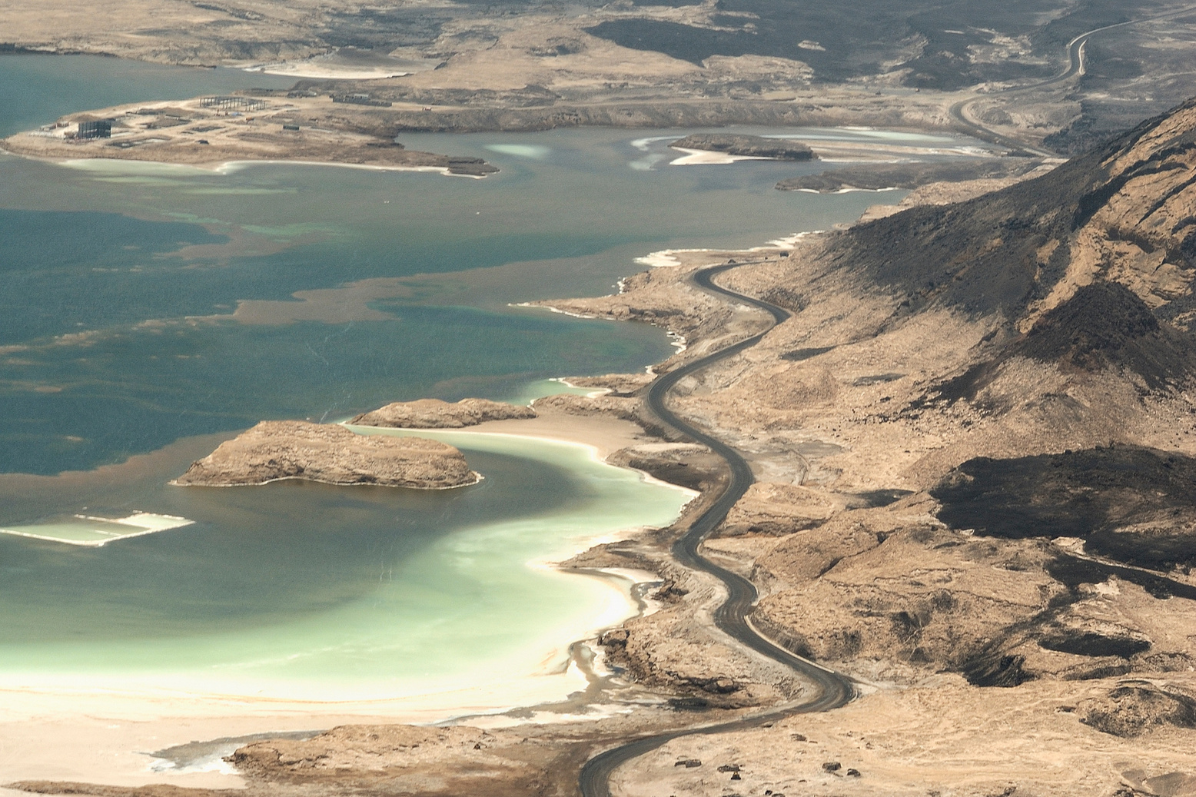
Economic and Tourism Data
GDP growth: +5% on average over the past decade.
Free zones and tax incentives: customs exemptions and facilitation measures for foreign investors.
Hospitality sector: +25% increase in hotels in Djibouti City and +43% in t he regions (2018–2025).
Accommodation capacity: +73% increase in rooms and +81% increase in available beds.
Tourist arrivals steadily increasing, reaching 126,618 in 2025.
Regional comparison: Djibouti benefits from security and political stability, as well as unique maritime accessibility at the regional level.

Slide 9
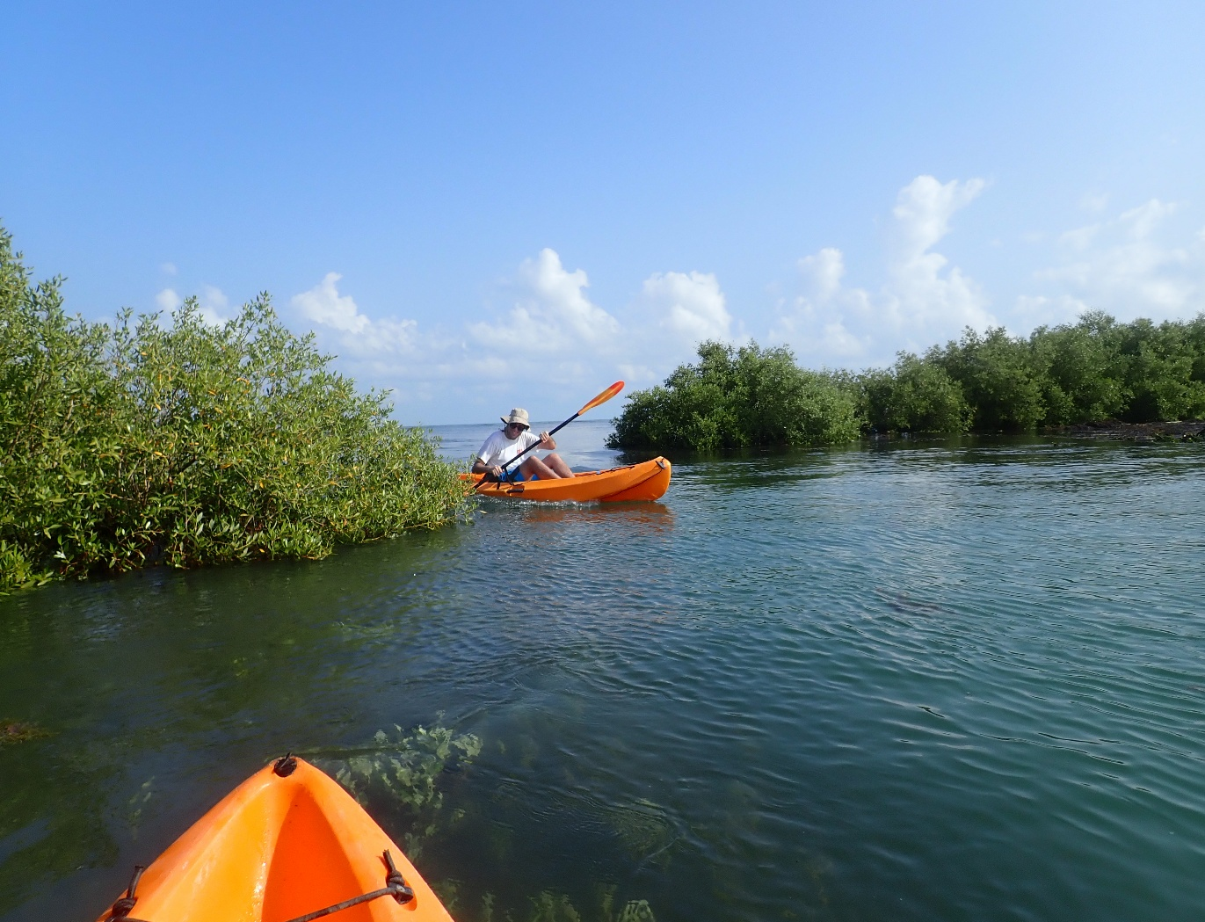
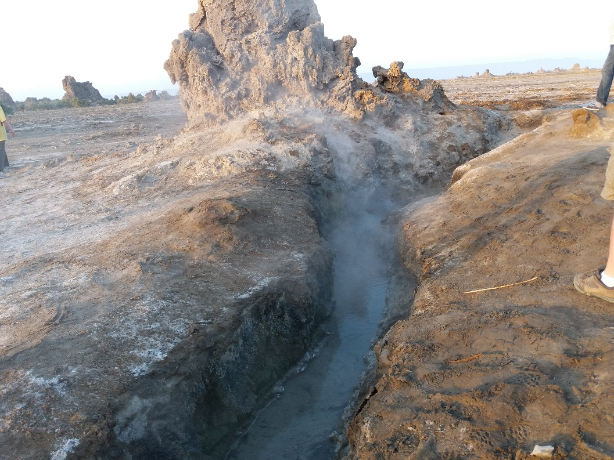
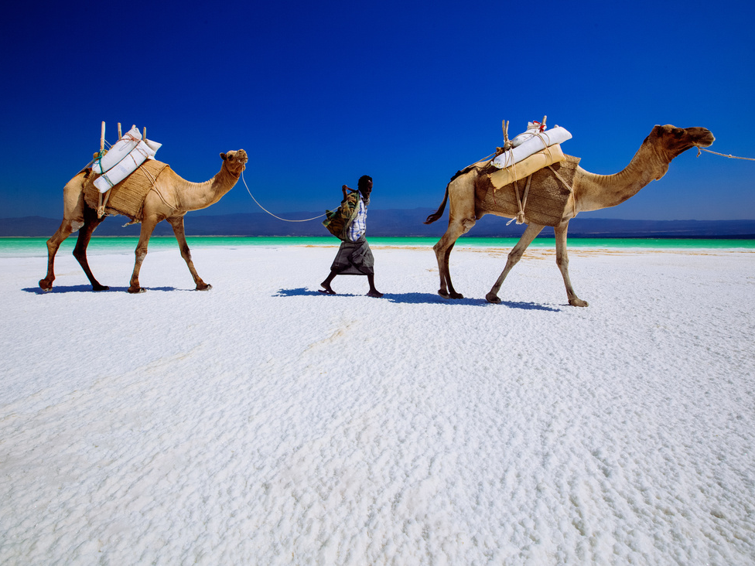
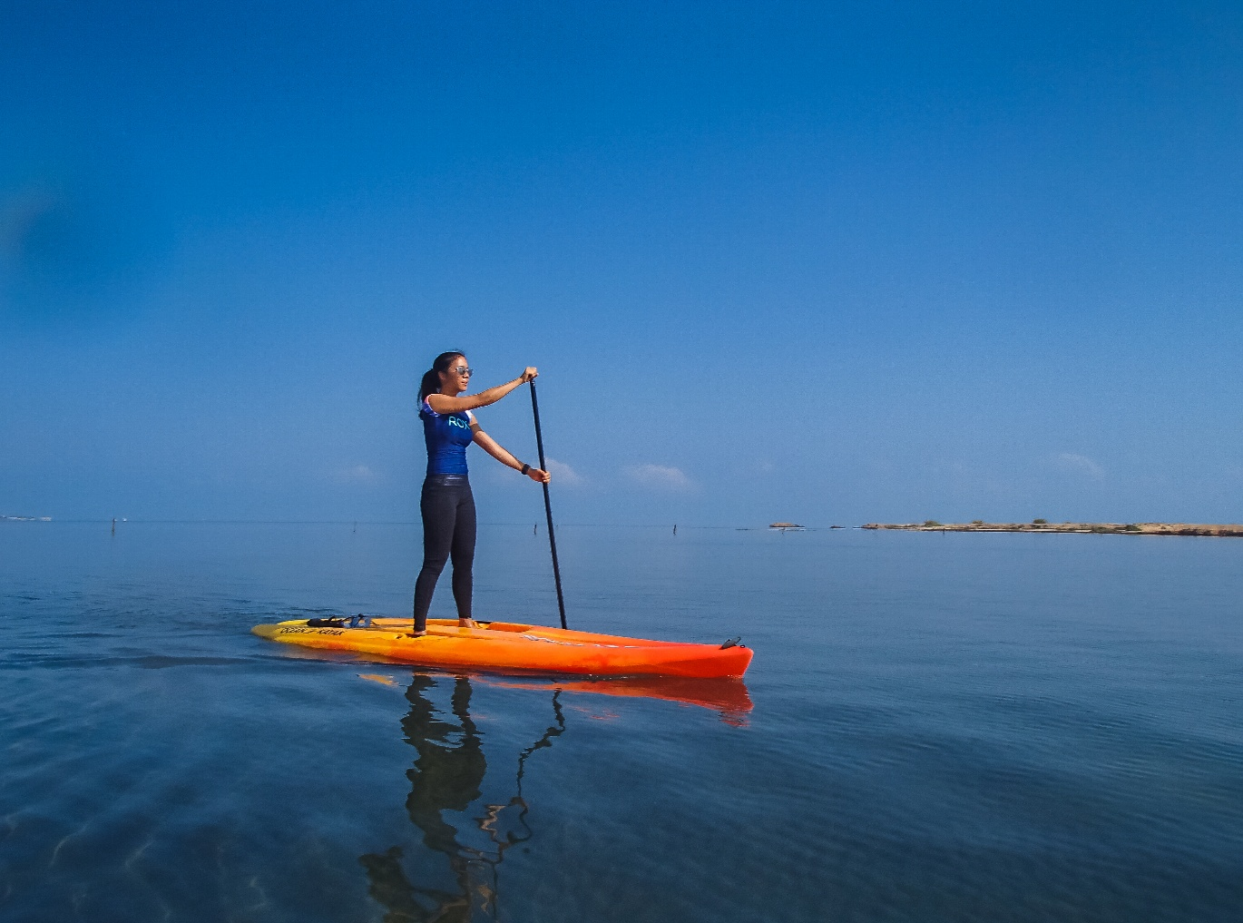
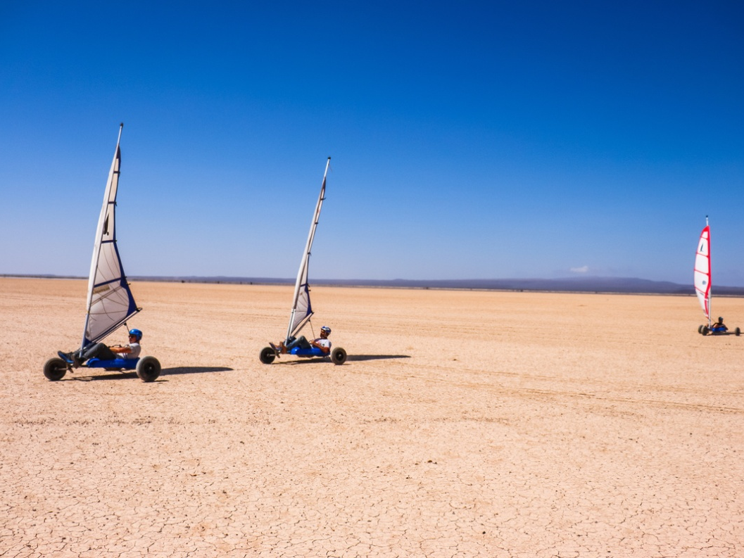
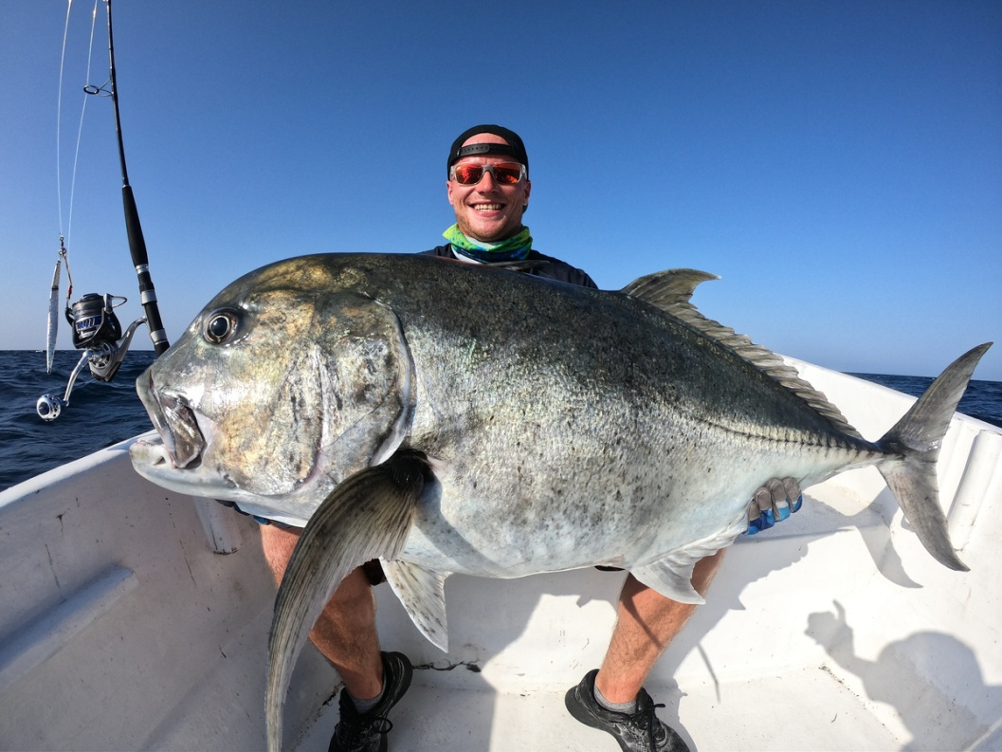
Djibouti: A land of sensations
Various sensations can be experienced through rich and varied activities. From scuba diving in the marvelous seabed through camel rides, hiking, Land sailing canoeing on the edges of beautiful mangroves, sport fishing, surf kit, ornithological observation up to the discovery of geological and archaeological landscapes, the country remains engraved, without forcing, in the memory of each visitor.

Slide 10
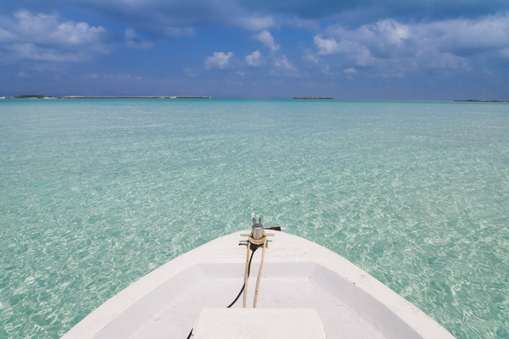
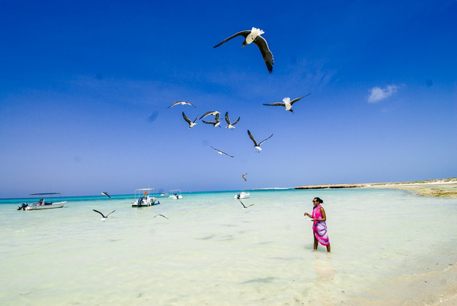
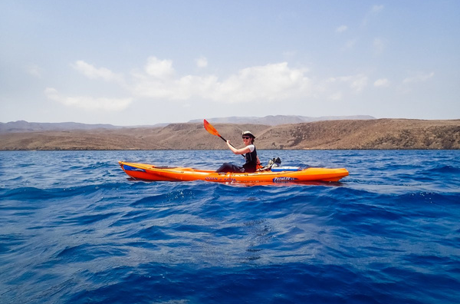

A SEA WITH TRANSPARENT WATER AND DREAM BEACHES

Slide 11
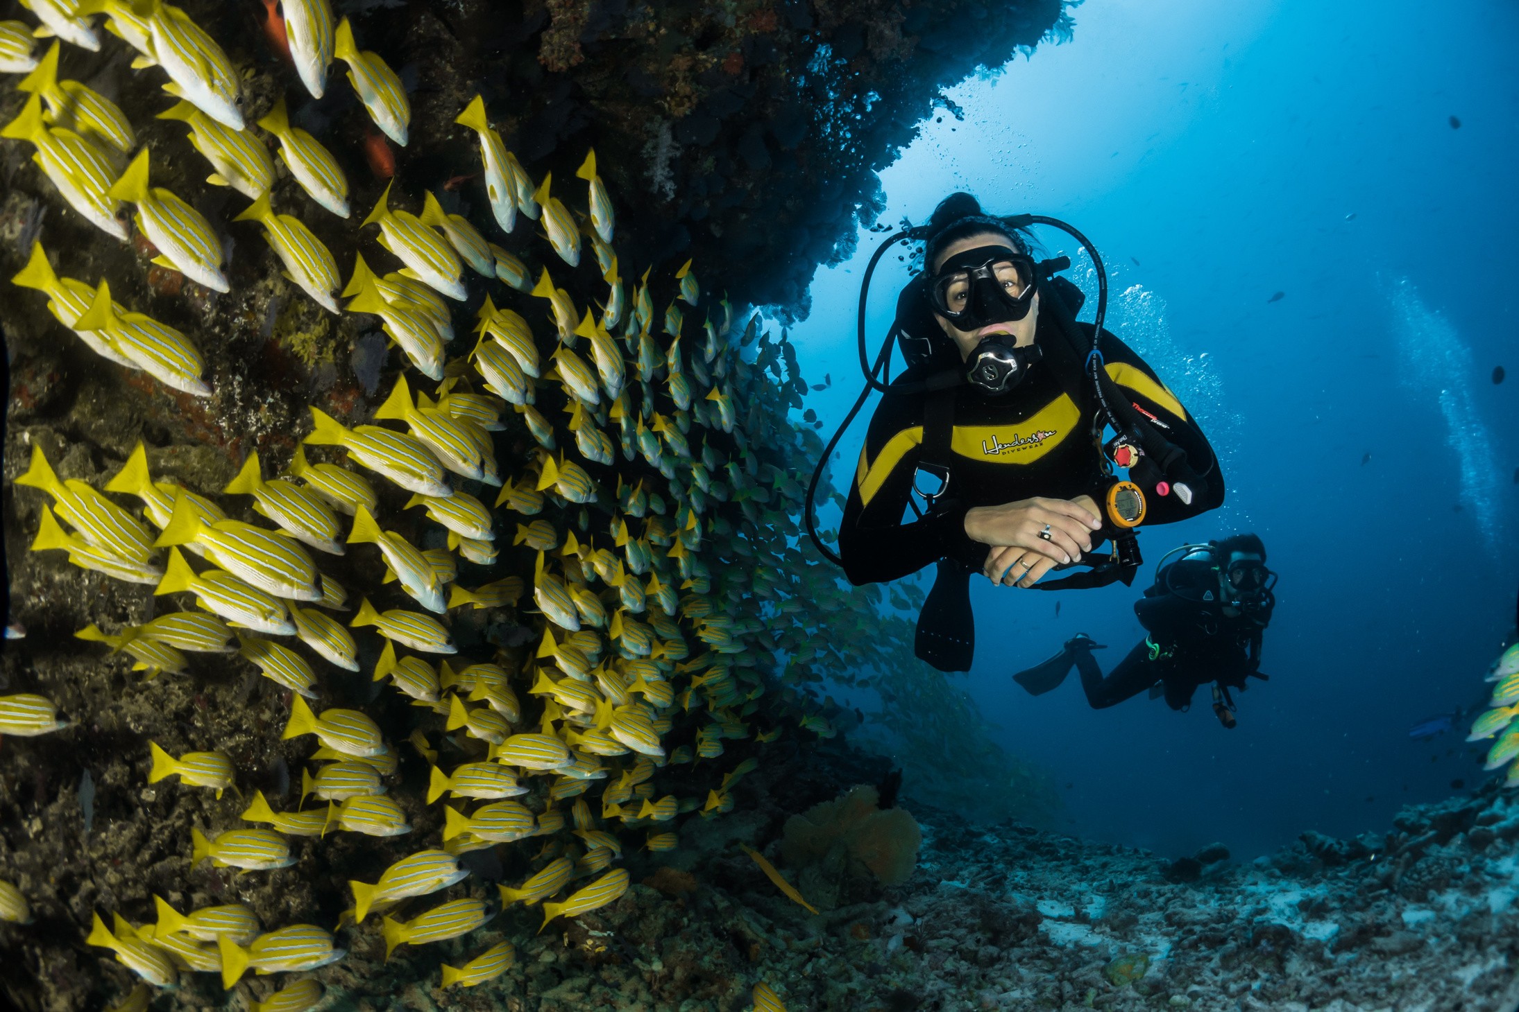
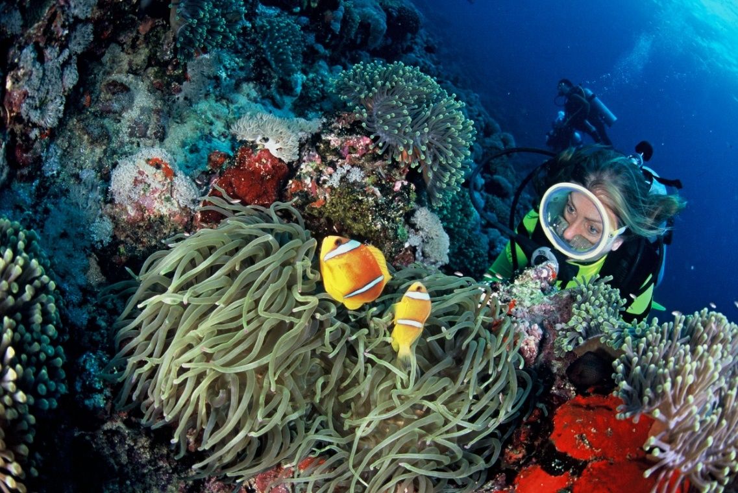
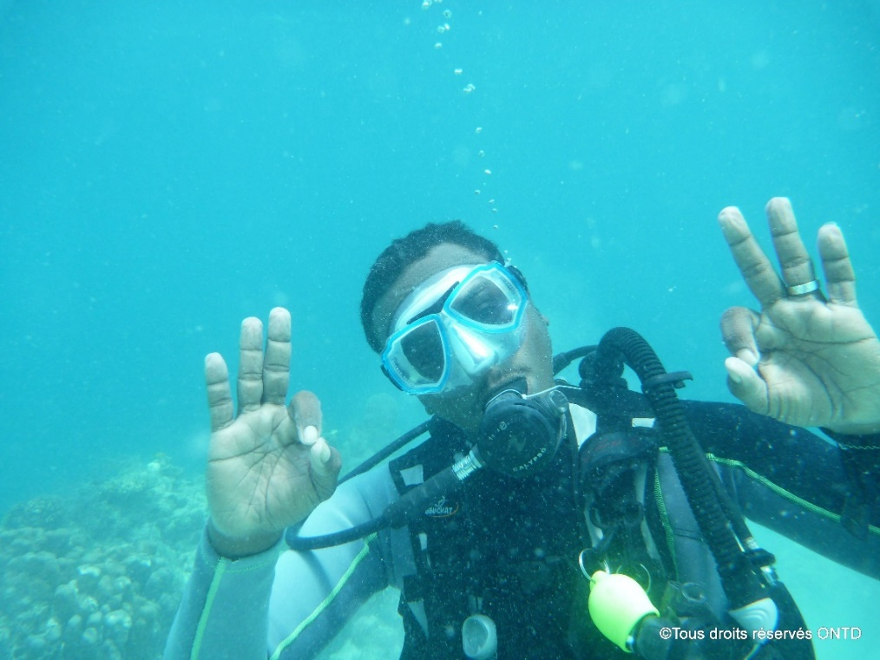
Djibouti and its touristics attractions
Plage Douda, Ile Moucha et Maskali, Godoria, Arta plage
From Ras Doumeira in the north to Loyada in the south, Djibouti boasts a 372-kilometre coastline and a well-preserved marine environment. Diving and marine life specialists consider the country’s seabed to be true underwater botanical gardens, home to more than 80 species of coral.

Slide 12
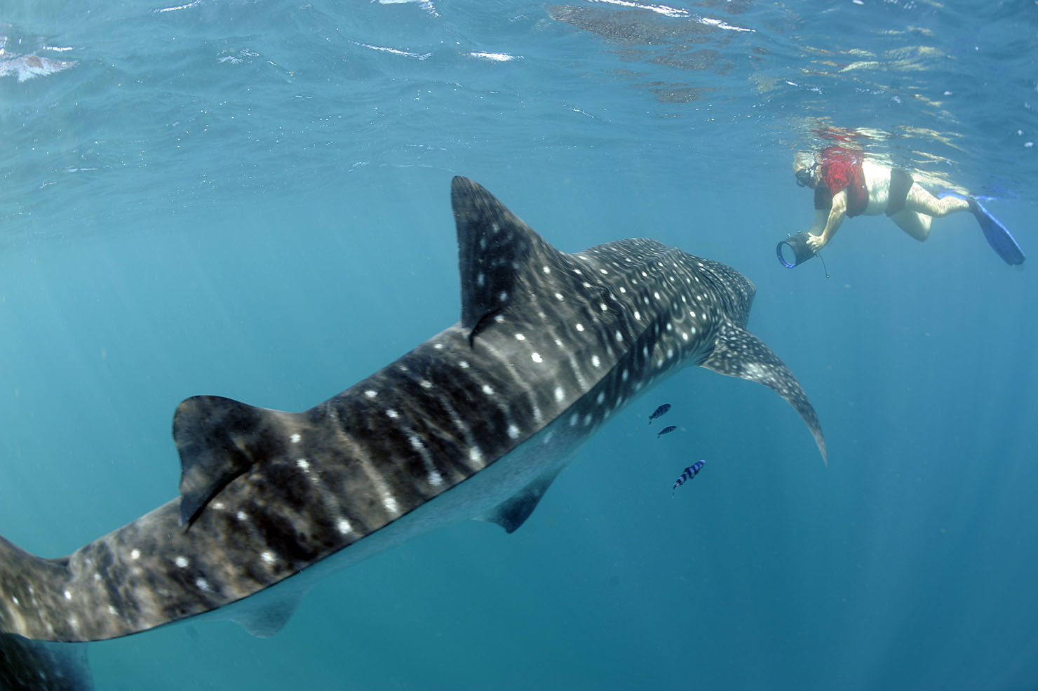
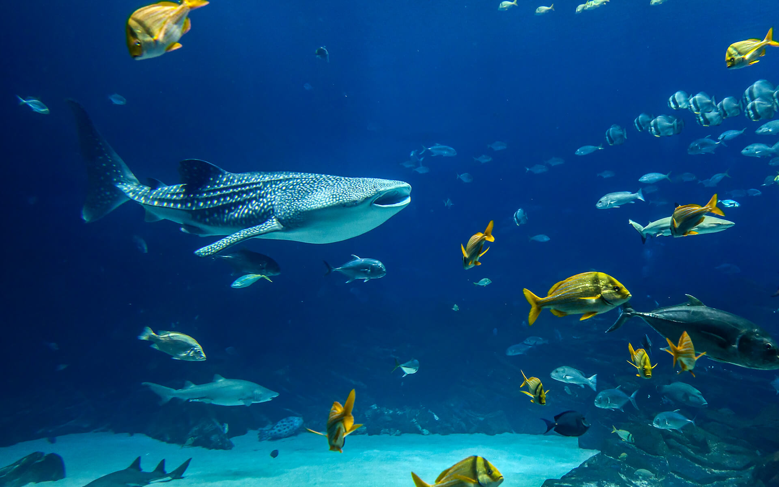
A UNIQUE ENCOUNTER WITH THE GIANTS OF THE SEAS, THE WHALE SHARKS

Slide 13
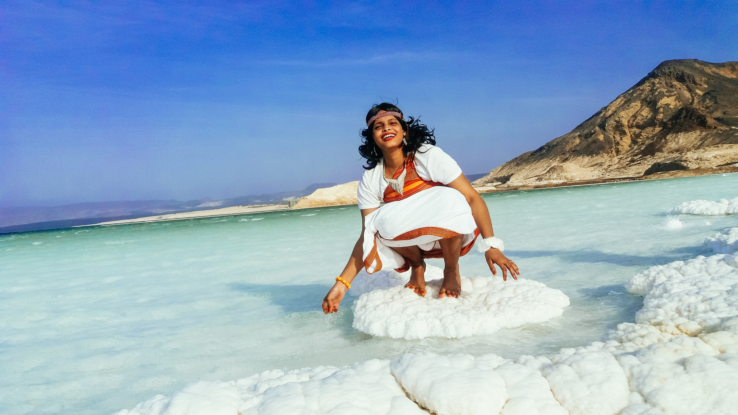
DJIBOUTI AND ITS TOURISTICS ATTRACTIONS
• Touristic site: Lake Assal
Lake Assal: is a salt lake located 153 meters below sea level (the lowest point in Africa).

Slide 14
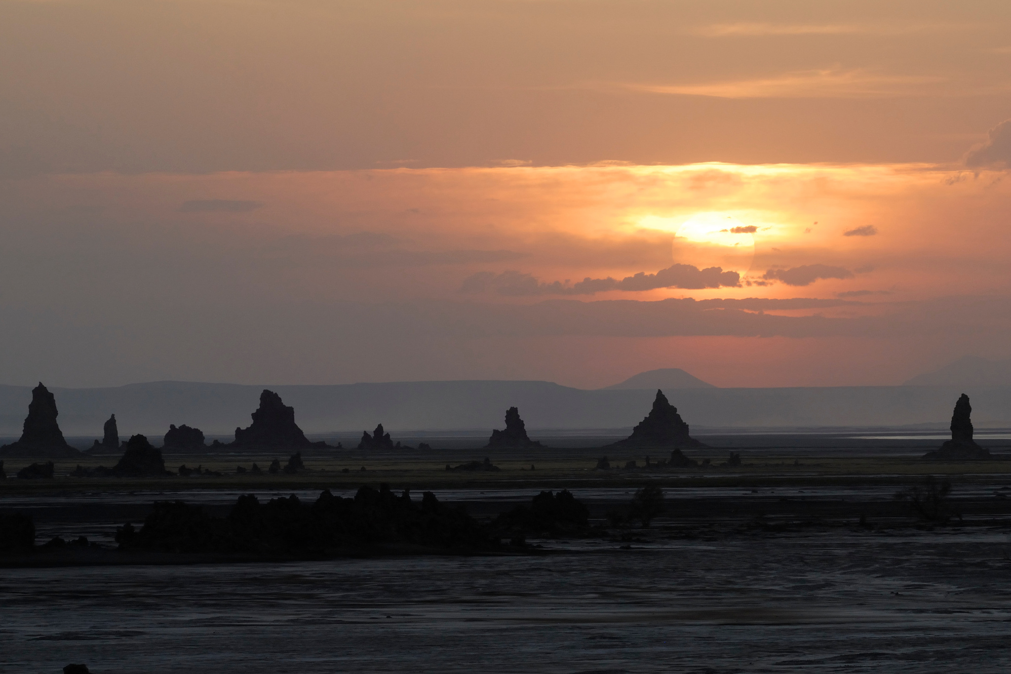
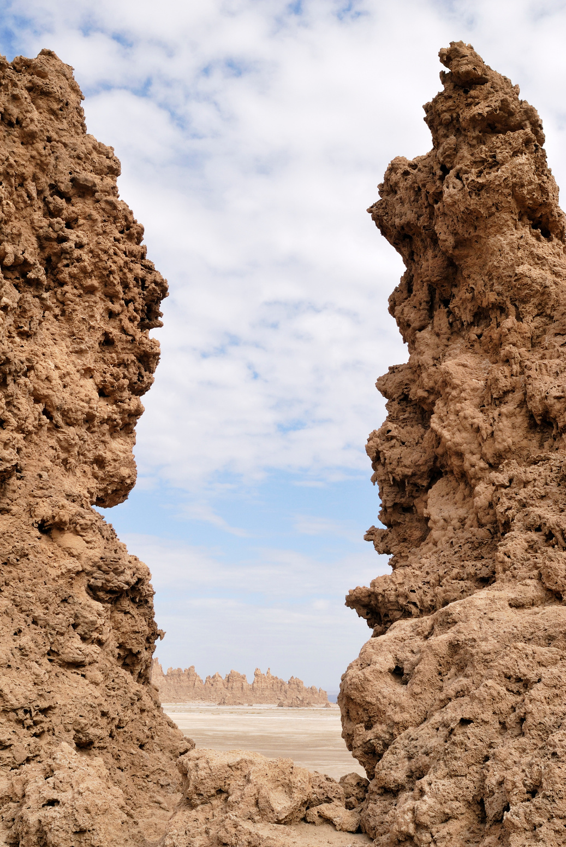
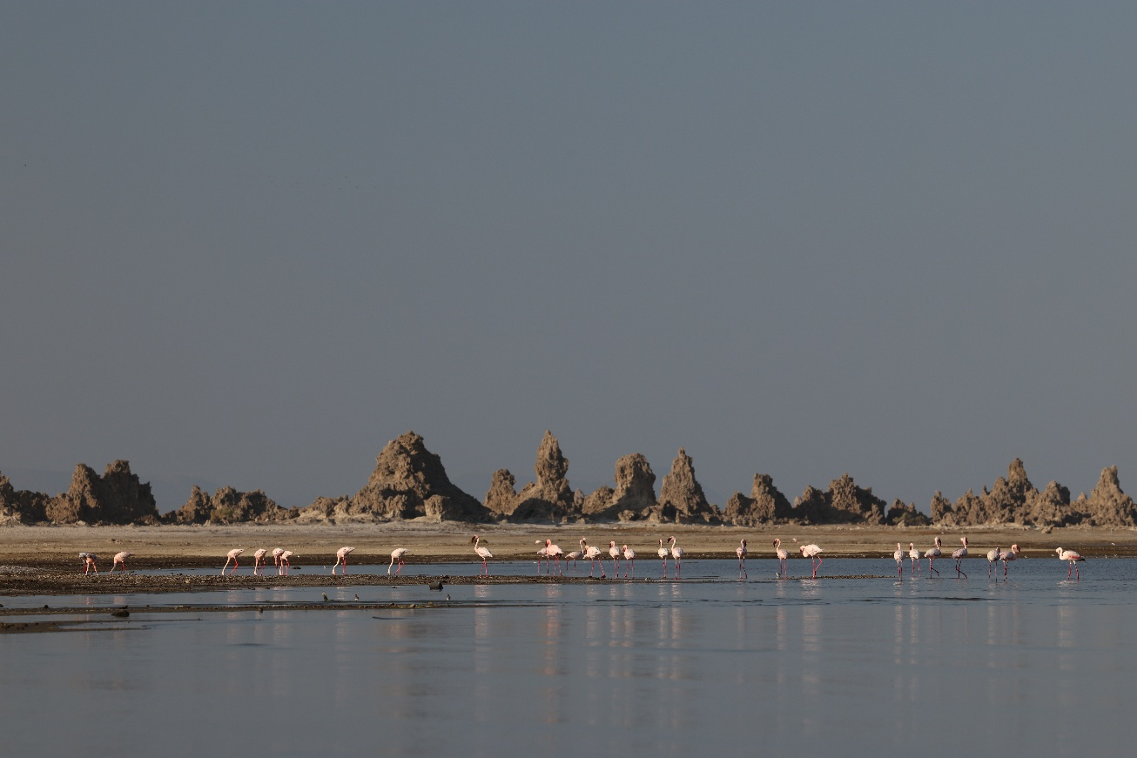
Djibouti and its touristics attractions
Touristic site: Lake Abbe
Lake Abbe: landscape of a fantasy world with hundreds of limestone chimneys and pink flamingos. Lake Abbe is also “lunar landscapes”.

Slide 15
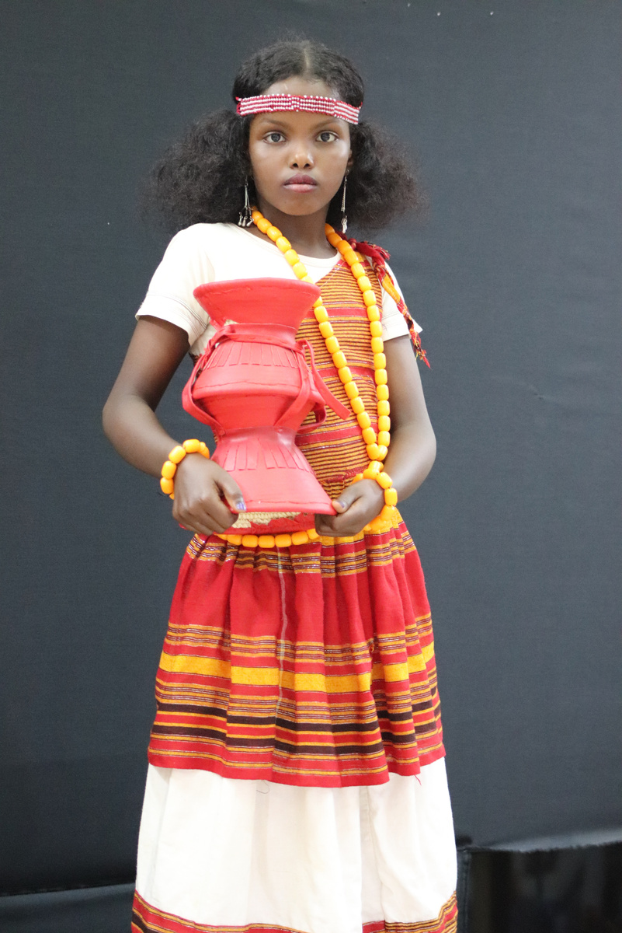
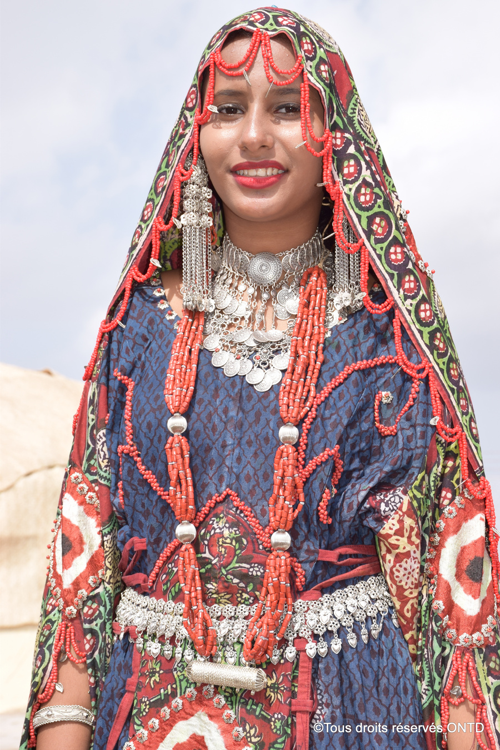
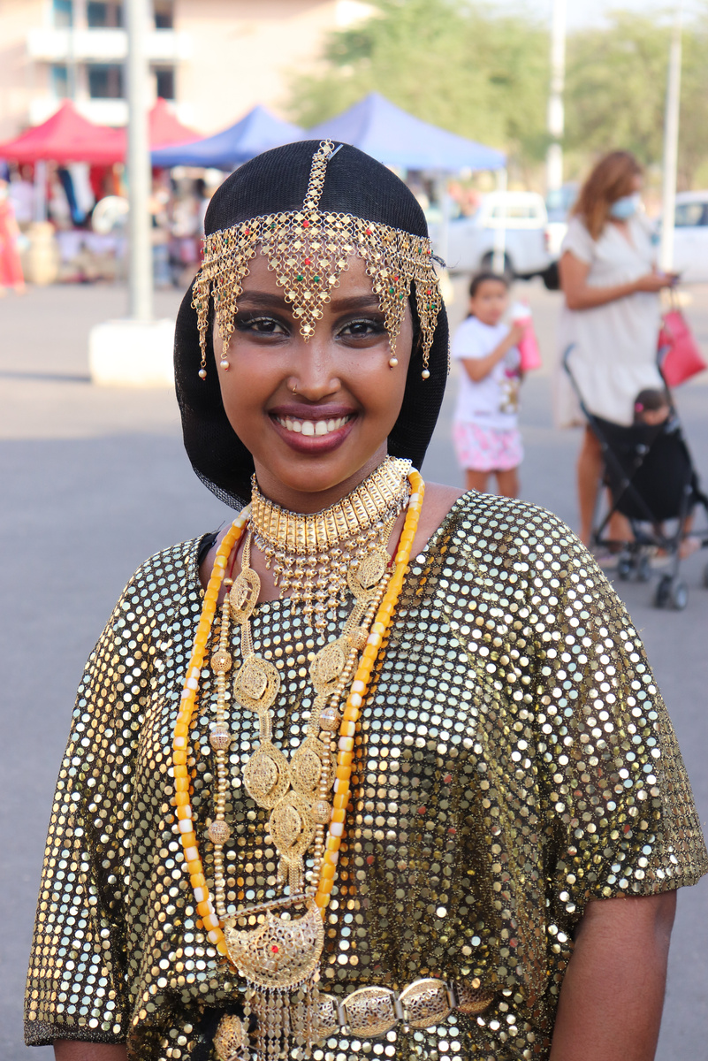
Djibouti and its touristic attractions
Cosmopolitan population: Djibouti is also a welcoming population as well as a rich and diverse culture.

Slide 16
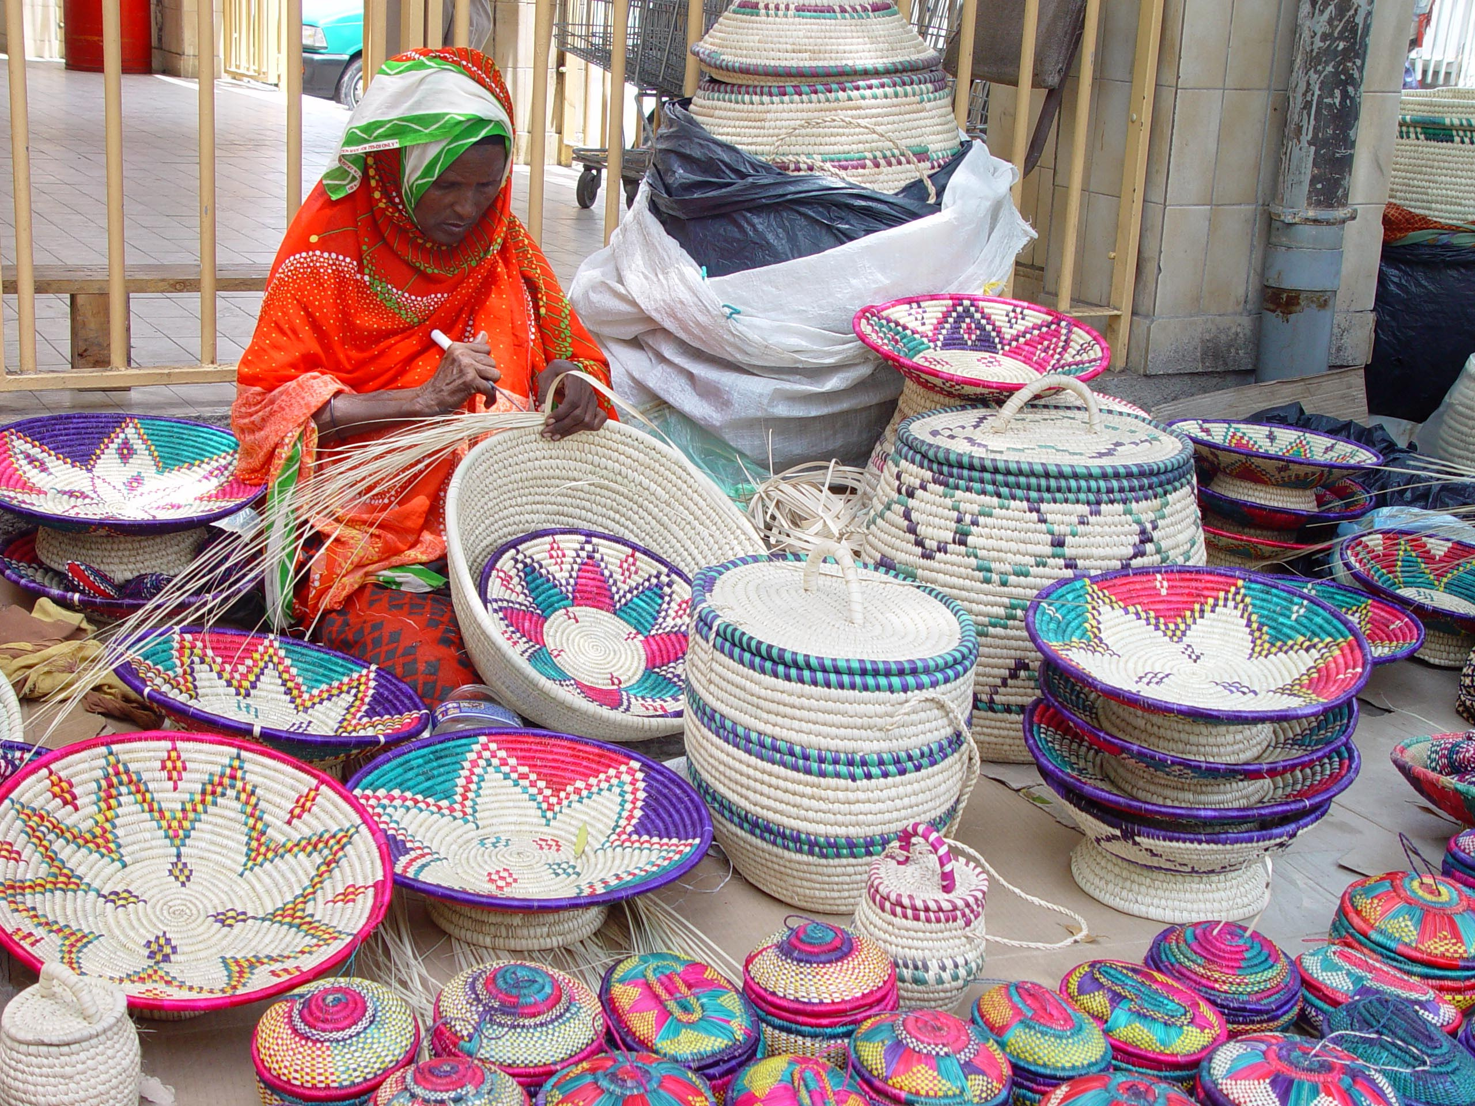
IT IS ALSO A CULTURE, TRADITIONS AND CRAFTS THAT ATTRACT TRAVELERS

Slide 17




NATIONAL TOURISM AGENCY OF DJIBOUTI
THANK YOU FOR YOUR KIND ATTENTION!!
+253 21 35 28 00
infotourisme@visitdjibouti.dj
www.visitdjibouti.dj

